Slide 1
Effects of Civic Administration Buildings on Restaurant Reviews
Jimmy Moore

Slide 2
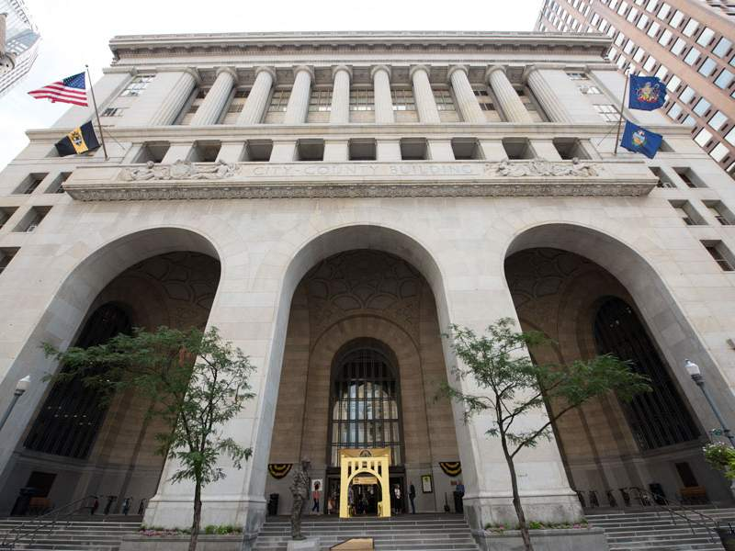

Goal
The stated goal of this project is to determine if proximity to buildings of civic administration has any meaningful impact on the online reviews for a restaurant.

Slide 3
Overview of Project
A webscrape of Yelp Restaurant reviews to find star ratings, number of reviews, and addresses
Review number will be used as a cutoff point to prevent data from being skewed
Usage of geocoding software to find coordinates of restaurants and civic buildings
Looking at five main civic buildings: City Hall, Courthouse, Police HQ, Jail, and Hospital
For the base case we will be using Pittsburgh, but plan to expand to other mid sized cities
Cleveland, Buffalo, Cincinnati, Wheeling…

Slide 4
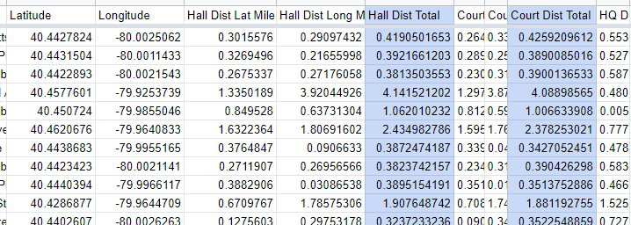
Geo locating
A peek into the process.
Note: One degree latitude = 69 miles, while one degree longitude = 54.6 miles
After applying conversions, Pythagorean theorem is applied to get total distance between buildings and restaurants

Slide 5
Prelim data analysis BS
When looking at each variable individually we see that (95% confidence intervals)
City Hall: Slope: -0.9414 to 3.195; p-value: 0.2768
Courthouse: Slope: -0.9416 to 3.204; p-value: 0.2760
Police HQ: Slope: -1.031 to 2.596: p-value: 0.3876
Jail: Slope: -0.8026 to 3.200; p-value: 0.2326
Hospital: Slope: -0.7076 to 3.265; p-value: 0.2002

Slide 6
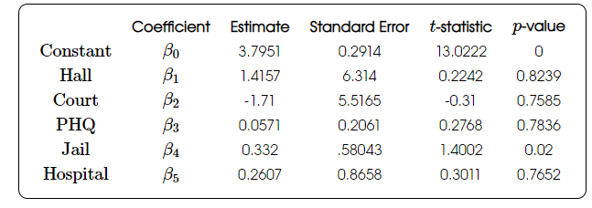
Making a General Equation
When putting all the variables into one equation however, one is left with this:
Which implies there might be some amount of significance with regards to how far a restaurant is from the County Jail

Slide 7
Talk about Other Analysis One Might Do
Looking at creating more nonlinear models
Perhaps there is a trade off where close is good/bad, but it evens out as you go farther
Making a model that can factor in human tendency to vote at the extremes
(Most people leave 1 or 5 star reviews, making every average subject to a high level of variance)

Slide 8
Implications
While by no means yet definitive, it suggests the possibility that location can directly impact a restaurants’ reviews in a way beyond its control
This might warrant a policy of the website to label certain areas as depressed or inflated, to give higher accuracy in their reviews
Could also suggest other trends that cannot be easily discerned by a viewer in the data
And would imply that there should be a push for more transparency or information

Slide 9
Ethical Implications
The Far More Interesting Project
If certain buildings are able to create areas of depression, then it is possible that certain communities can create areas of depression as well
If this is the case, it is likely that these areas of depression are around black and brown communities
Which with lower reviews drives business in those areas down and perpetuates a cycle of inequality

